Slide 1
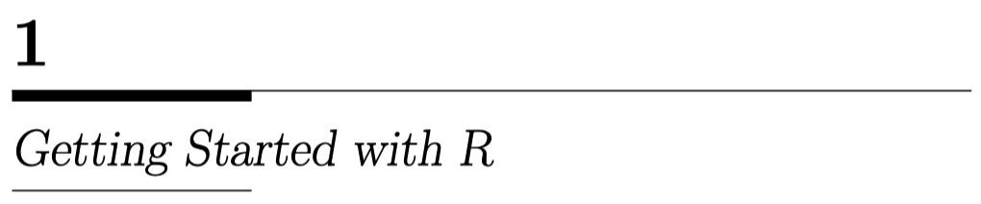
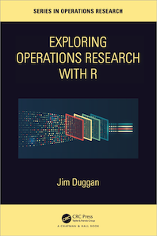
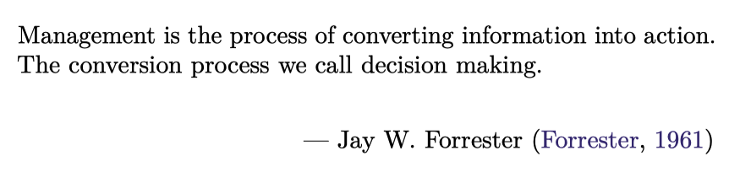

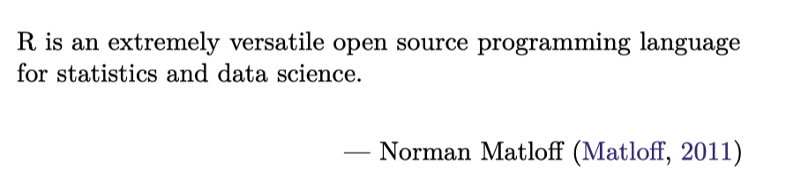
https://github.com/JimDuggan/explore_or

Slide 2


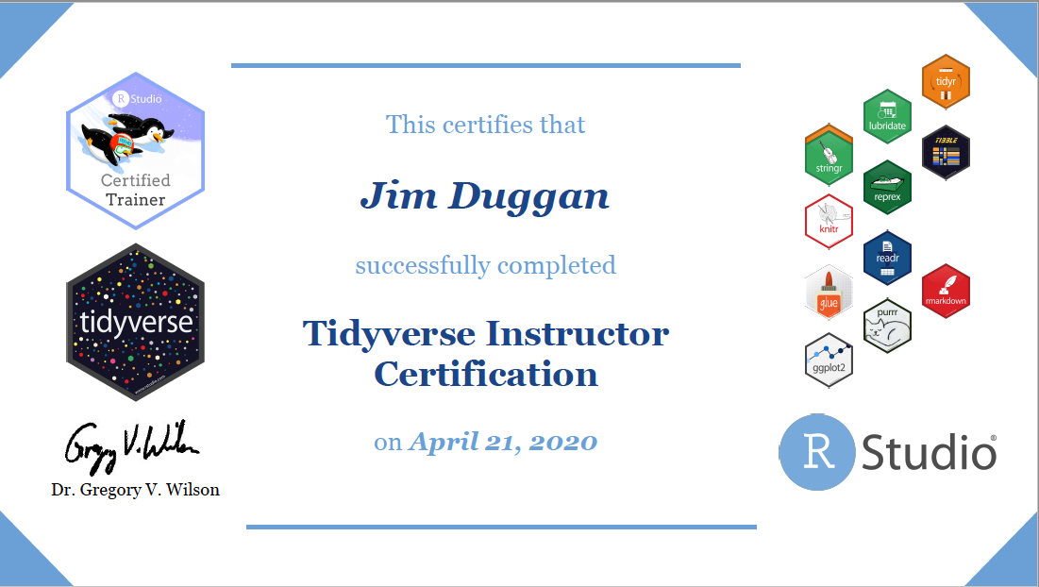
Instructor –Jim Duggan
Lectures in
Programming (R, MATLAB),
Modelling & Simulation
Research interests:
System Dynamics
Computational Epidemiology
Data Science

Slide 3
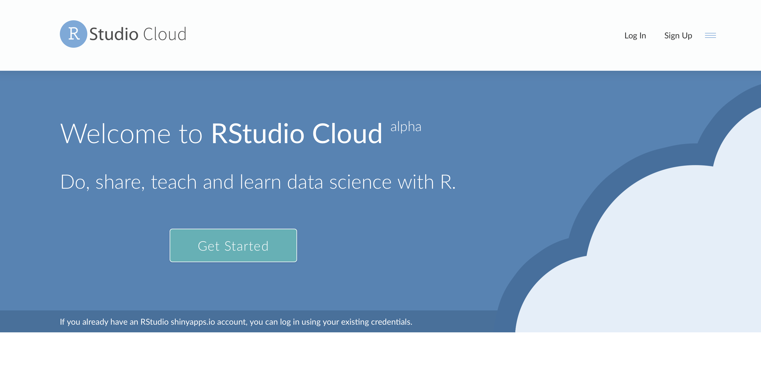
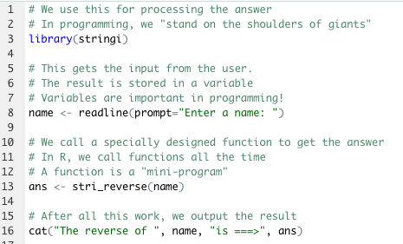
The R Project for Statistical Computing
R’s mission is to enable the best and most thorough exploration of data possible (Chambers 2008).
It is a dialect of the S language, developed at Bell Laboratories
ACM noted that S “will forever alter the way people analyze, visualize, and manipulate data”

Slide 4
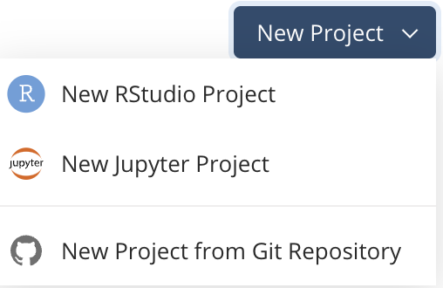
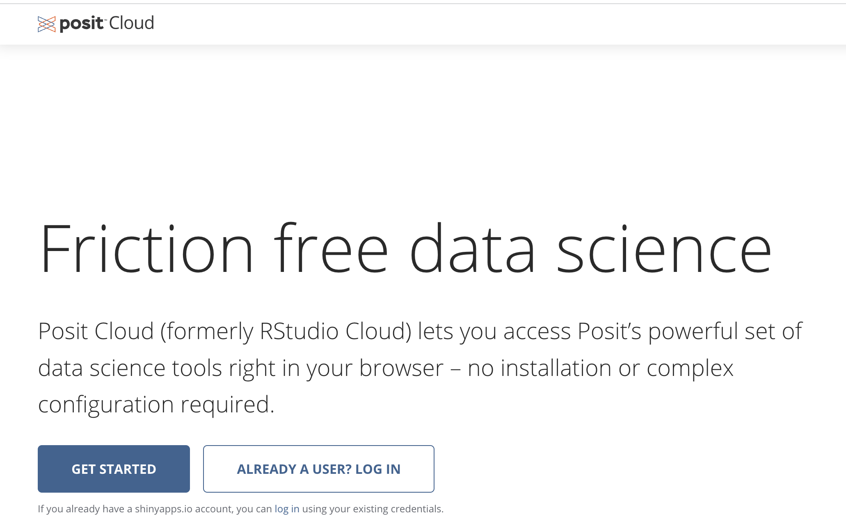
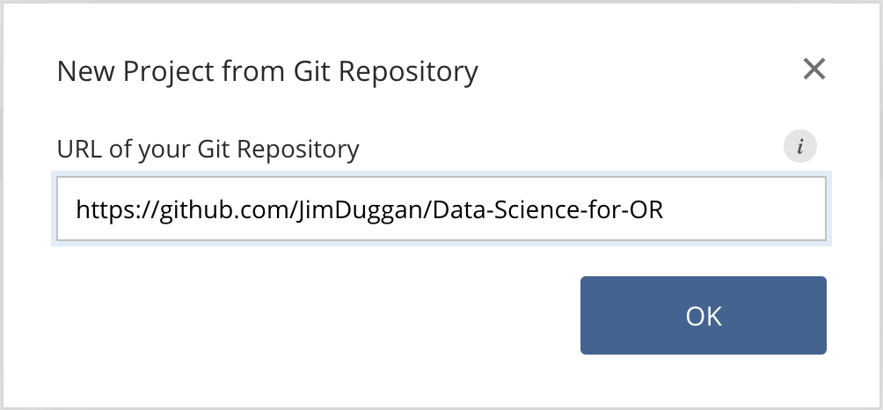
First Steps: Posit Cloud – Create Your Account

Slide 5
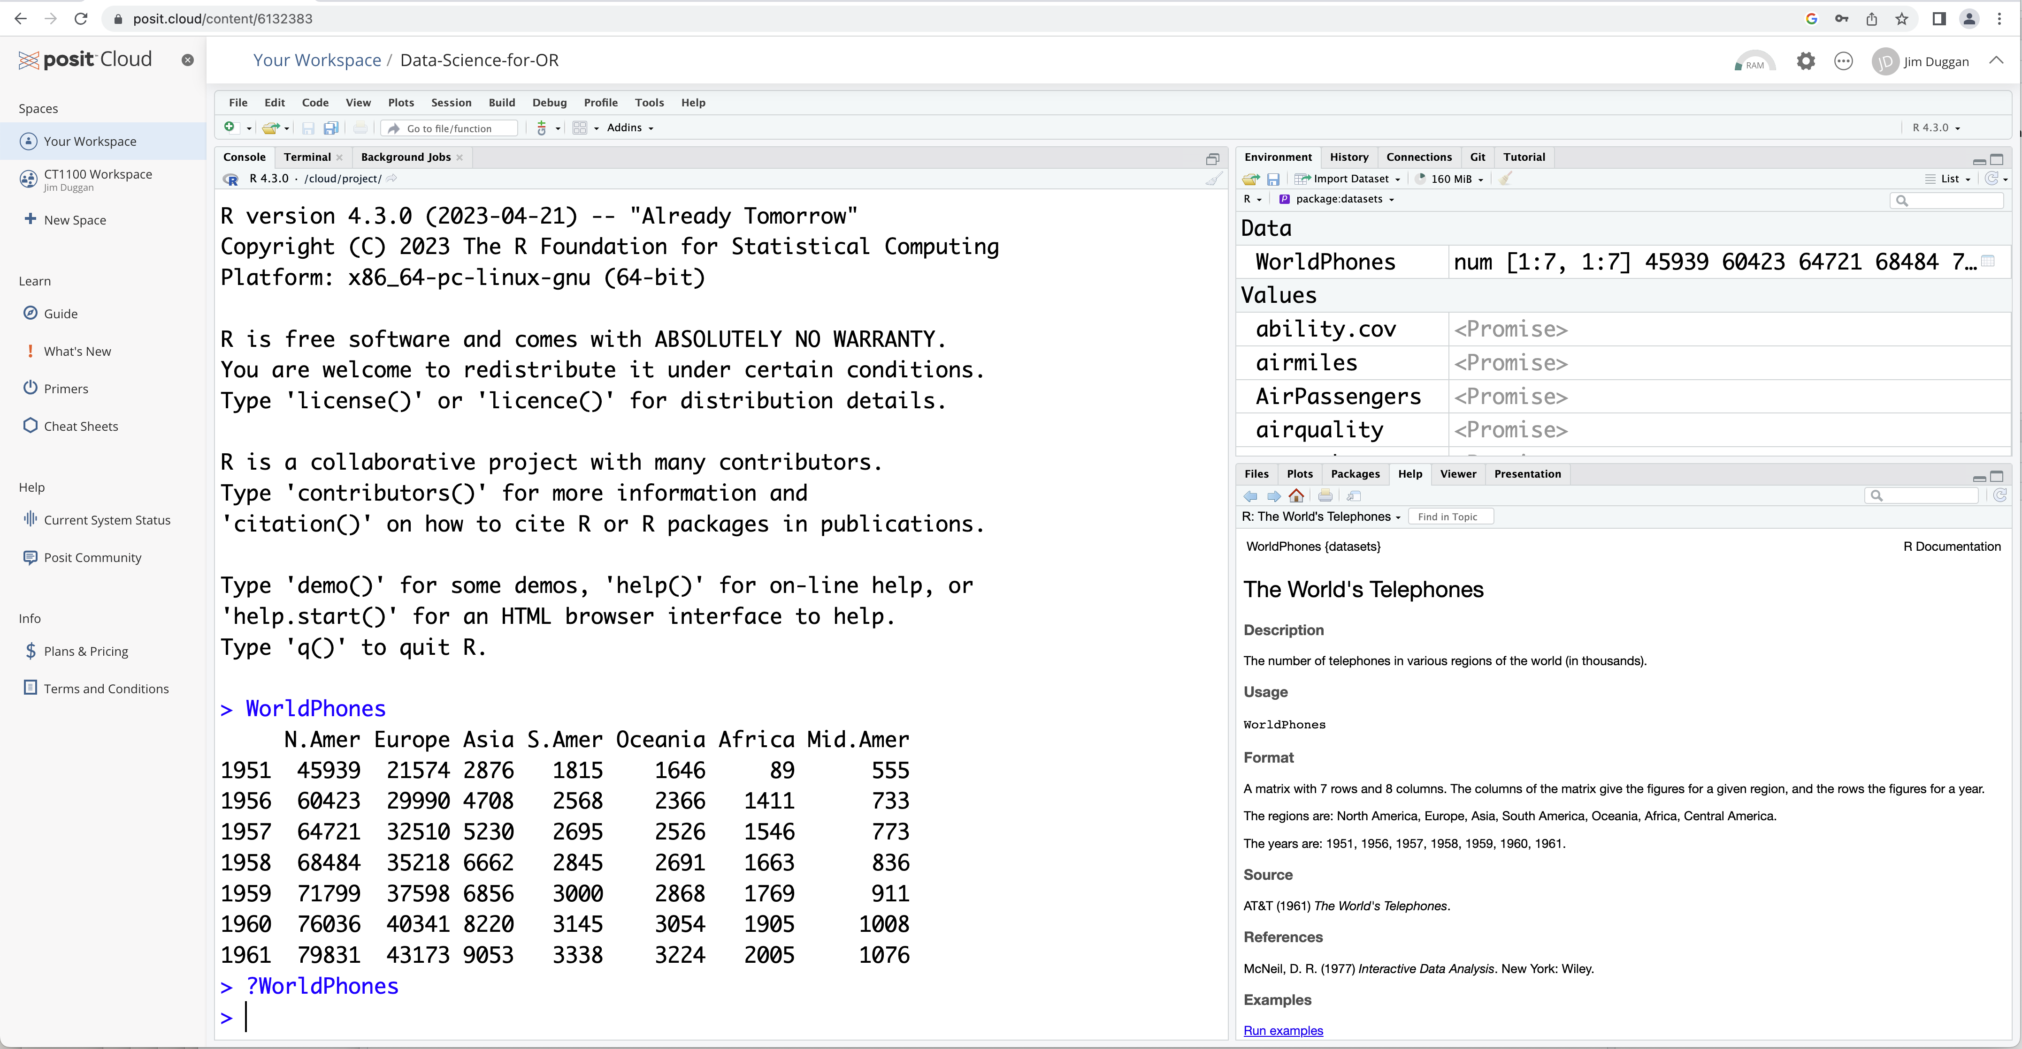
View the R IDE

Slide 6
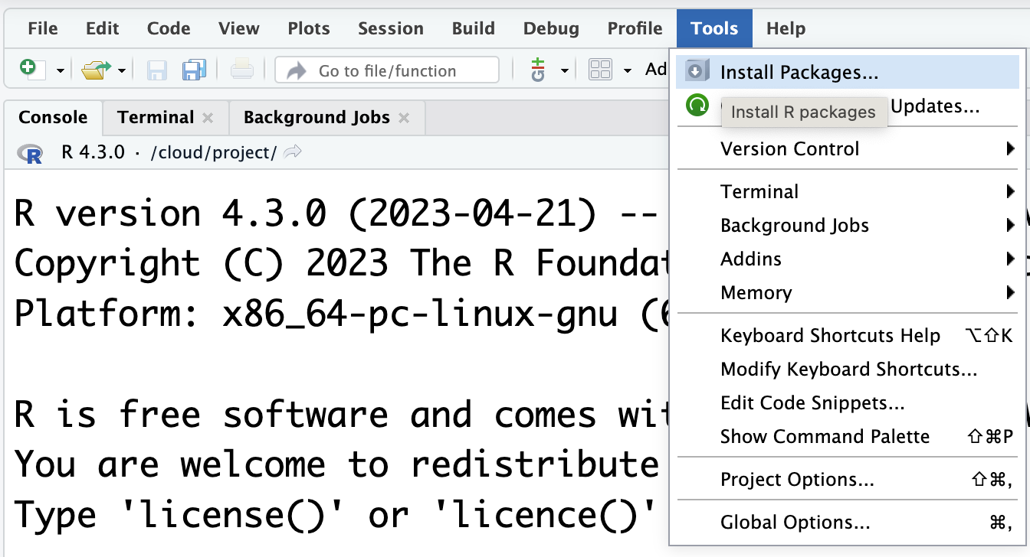
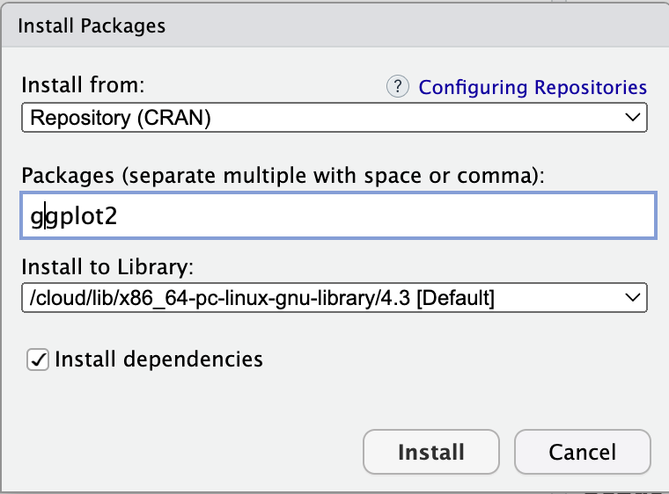
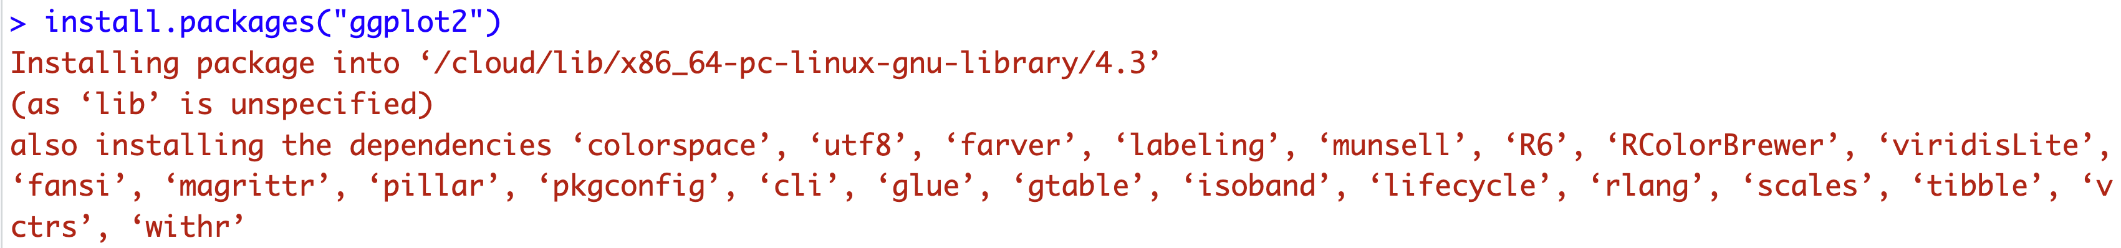
(5) Install packages…

Slide 7
Some packages required…
Package | Purpose
ggplot2 | Produce graphics for data
dplyr | Analysis of data held in tibbles/data frames
aimsir17 | 2017 Weather data for Ireland
purrr | To iterate over data structures
tidyr | To tidy rectangular data, and to nest data sets

